Slide 1


Mentoring Europe - Mentoring Meet & Match
November 2023

Slide 2



Two observations
Young people from migrant backgrounds have more difficulties accessing the labour market
The experience and skills of over-50s are not sufficiently valued
Notes:
‹#›

Slide 3




Our mission & goals
DUO for a JOB puts job-seeking young people with a migration background in touch with over-50s, who volunteer to transmit their professional experience to guide them in defining their vocational project and finding a job.
Improve social and vocational integration for young people
Appreciate and make use of skills and experience of over-50s
Strengthen social cohesion and local
solidarity
Notes:
‹#›

Slide 4





DUO, it’s:
6500
duos matched since 2013
2000
active mentors
17 branches
in Belgium, France & the Netherlands
88
employees
Notes:
‹#›

Slide 5


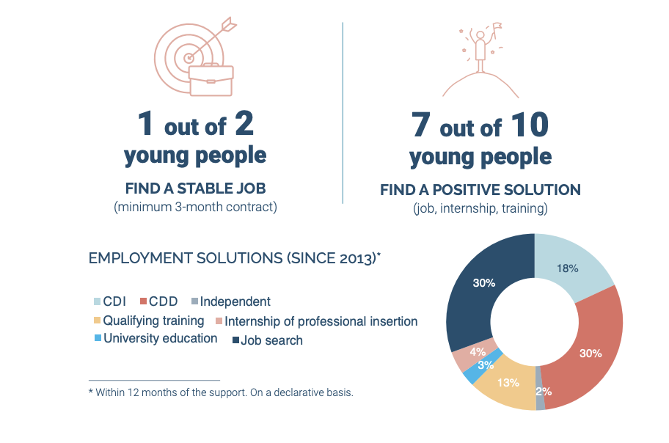
Our impact
Notes:
‹#›

Slide 6


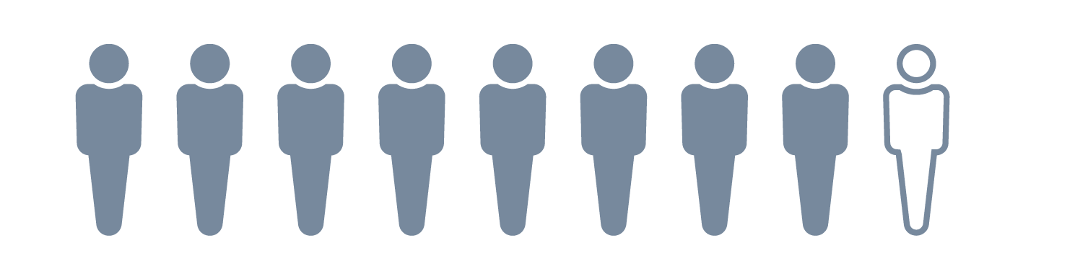
Our impact
For the mentees :
regain confidence in themselves and their potential
developp their network and social capital
have a better knowledge of the labour market
master the job search tools (CV, application letters,...)
For the mentors :
feel active and useful by passing on their experience and skills
connect with young people (their realities, challenges, dreams, etc.)
being informed and involved in a stimulating environment
9 out of 10
mentors repeat the experience

Slide 7


Mentoring: a cross-sectoral tool to foster social inclusion
What is advocacy?

Slide 8

DEFINITION
Advocacy is a process of collective action originating in civil society with the aim of influencing decisions from and for a certain vision of the society
Ad voc = "to give voice to", to advocate for a specific group
From and towards a vision of society
≠ Lobbying: influencing a decision in favor of private interests

Slide 9

You can advocate for mentoring AND you can also advocate for the groups you work with, in complement to the individual solution of mentoring.
Notes:
‹#›

Slide 10


A variety of format
Directly or indirectly
Formally or informally
Through collaboration or confrontation
A variety of target
Politics/public authorities or Companies
local, regional, national or international
Legislative or government

Slide 11

Mentoring: a cross-sectoral tool to foster social inclusion
How to advocate?

Slide 12

STEP 1: Create your experience on the field
Create operational experience
Learn from the field
Listen to the people

Slide 13

STEP 2 : Collect data & testimonies
Since the start, put in place protocol of collecting and managing and analysing data
Take time to collect testimonies

Slide 14

STEP 3: Define CLEAR goals based on your experience
Based on your experience and in your specific environment:
What do you want to reach?
Are you advocating for mentoring? If yes, would you like financial support? Change in the law/rules/administrative framework?
In general, which systemic change would you like to see?

Slide 15

STEP 4: Build your expertise
You are a field expert and your expertise is your legitimacy >> Ideology is not enough... You need to “master” the topic.
Understand the topic : read and ask
Speak about you know (representativity and legitimacy)
Take a step back and analyze your data
Gather testimonies
Start to draw conclusion
Define CLEAR recommendation

Slide 16

STEP 5: Know your environment
Decision makers/Politicians
Public services & civil servant
Researchers
NGO’s
Civil society
Union trade, Companies
Media
Make sure you know them and… they know you !

Slide 17

STEP 5: Know your environment
Keep you up to date
Follow up the News
Monitor academic research
Monitor social networks and NGO’s activities
Monitor the political agenda
Tools: publications, press, social media, conferences, newsletter

Slide 18




STEP 6: Disseminate your expertise
Information: research, publications, seminars
Awareness: media, conferences, events ...
Mentors and mentees are you best ambassadors !

Slide 19

STEP 7: Develop your network and target the right person
Lobby decision-makers
Identify who has decision-making power at what level (stakeholder mapping)
Create a dialogue with these actors
Build a long-term relationship
Offer your expertise
Deploy your advocacy strategy
Directly: meetings, letters, media actions, social networks
Indirectly: via the media, parliamentary questions, other organizations, advisory bodies
Don’t forget to use the opportunities
in terms of people
in terms of Momentum

Slide 20

Lessons learned
The quality of your field work is your best argument
Advocacy is a very long-term game and it requires resources
You have to be patient and collect small victories
You have to be willing to wait and patiently build trust and strength
It requires constancy and a strategy linking information, awareness and mobilization

Slide 21







www.duoforajob.be - www.duoforajob.fr - www.duoforajob.nl

